Slide 1
eBay: The Global Marketplace
Under Guidance of Mrs. Vaishali Sonawane Mam.
by:v.lakshman

Slide 2
Introduction :
eBay is a global online marketplace that facilitates consumer-to-consumer and business-to-consumer sales.
The website connects millions of buyers and sellers globally, offering a wide range of categories such as electronics, fashion, home & garden, collectibles, motors, sporting goods, and more.
it has grown to become one of the largest e-commerce platforms in the world.

Slide 3
Overview
What is eBay?
Founded in 1995 by Pierre Omidyar.
A global e-commerce corporation that facilitates consumer-to-consumer (C2C) and business-to-consumer (B2C) sales.
Known for its auction-style listings, but also offers "Buy It Now" options.
Mission: "To connect millions of buyers and sellers around the world, empowering people and creating economic opportunity for all."

Slide 4
Modules
Module 1 : Sign in page
Checked all the functionalities on Sign in page which included personal info as email address, password.
Module 2 : shop by category
Checked all the functionalities on shop by category feature which included a list of broad product classifications that help users navigate and find specific items
Module 3 : search and filter
checked a search bar which is used to find products.and includes filters for categories,price ranges,brands,and other attributes.
Notes:
Module 1: Signn in page
Checked all the functionalities on Sign in page which included personal info as email
address, password
Module 2: Women page
Checked all the functionalities on Women page which included item details, Quantity, Filters,compare button,Add to cart button,product info,grid,list button
Module 3: Tshirt page
Checked all the functionalities on T-Shirt page which included item details, Quantity, Filters,compare button,Add to cart button,product info,grid,list button
Module 4: All Buttons and Drop Down Arrow :
team checked if all the buttons and drop down arrows of different fields are functioning properly or not

Slide 5
Module 4: electronics Page
Checked all the functionalities on Electronics page which included item details,quatity selection,filters,sort options,compare button,add to cart button,product info,grid/list view buttons,wishlist
Module 5 : shopping cart
allows users to add items to their cart and manage their selections before checkout and supports saving items for later and viewing total costs
Module 6 : checkout module
Checked facilitates the payment process,including options for credit/debit cards,paypal,and gift cards,includes order summary and shipping information
Notes:
Module 1: Signn in page
Checked all the functionalities on Sign in page which included personal info as email
address, password
Module 2: Women page
Checked all the functionalities on Women page which included item details, Quantity, Filters,compare button,Add to cart button,product info,grid,list button
Module 3: Tshirt page
Checked all the functionalities on T-Shirt page which included item details, Quantity, Filters,compare button,Add to cart button,product info,grid,list button
Module 4: All Buttons and Drop Down Arrow :
team checked if all the buttons and drop down arrows of different fields are functioning properly or not

Slide 6
Module 7: order management
enables users to view their order history,track shipments,and manage returns.
Module 8 : feeback and rating
allows buyers to leave feedback and ratings for sellers after transactions and displays seller ratings to help users make informed decisions.
Module 9 : customer support
Show offers faq’s,live chat,and support ticket systems to assist users with their inquiries.

Slide 7
Defects
While running a testcase at certain point some fields are not working as it is expected which is nothing but a defect, so I have created a Defect report on those defects.

Slide 8
Defect identifier :- B_001
Defect summary :- items added to the cart are visible in mini-cart or header icon,but when navigating to the cart page,it shows empty.
Ø Test Id :- Ds-001
Ø Test case name :- Verify_Items_Appearing_in_Cart_Page_After_Adding
Ø Module name :- shopping cart/add to cart
Ø Reproducible :-
Ø Severity :- high
Ø Priority :- high
Ø Raised by :- lakshman
Ø Assigned to :- developer
Ø Date of assignment :- 19-08-2025
Ø Status :- pending
Ø Snap shots :-
Ø Fixed by :- developer
Ø Date of fixing :-

Slide 9
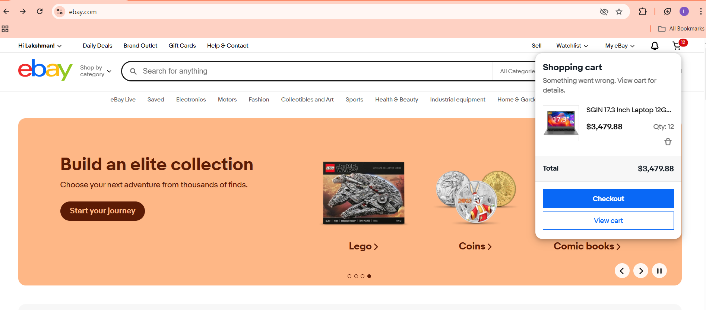
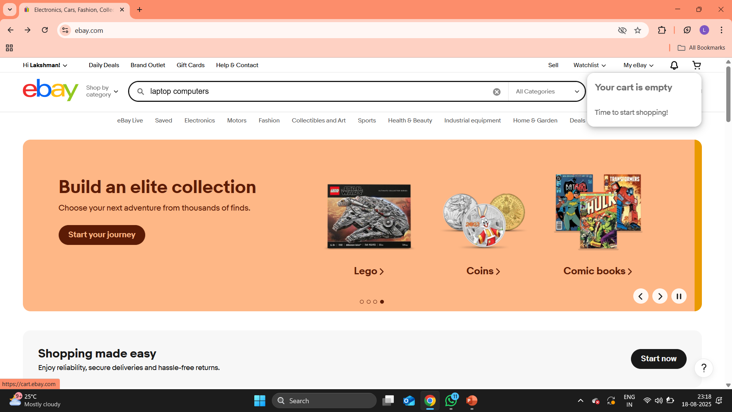
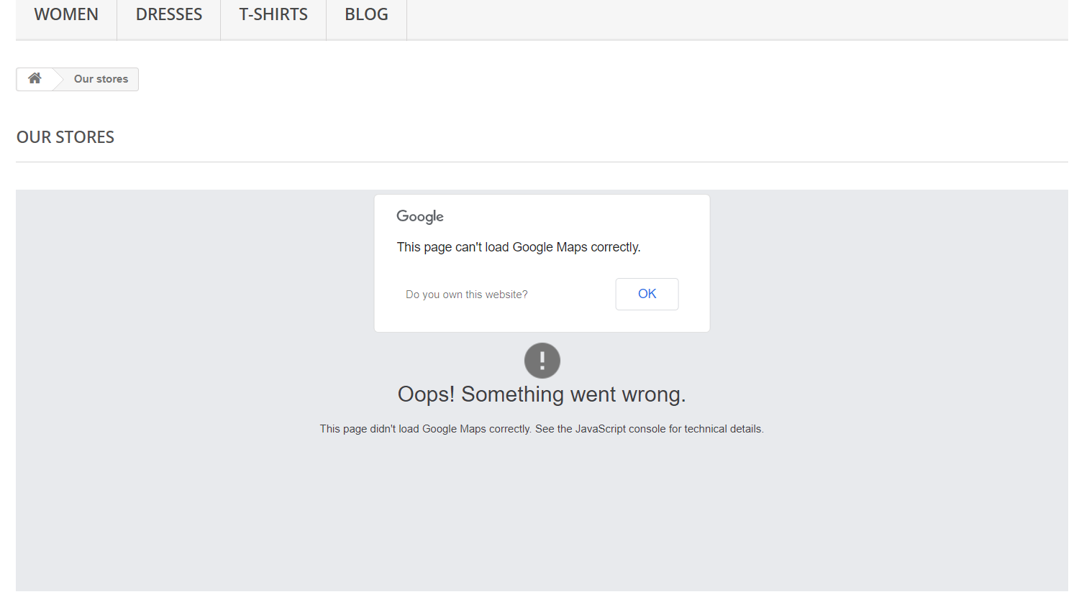
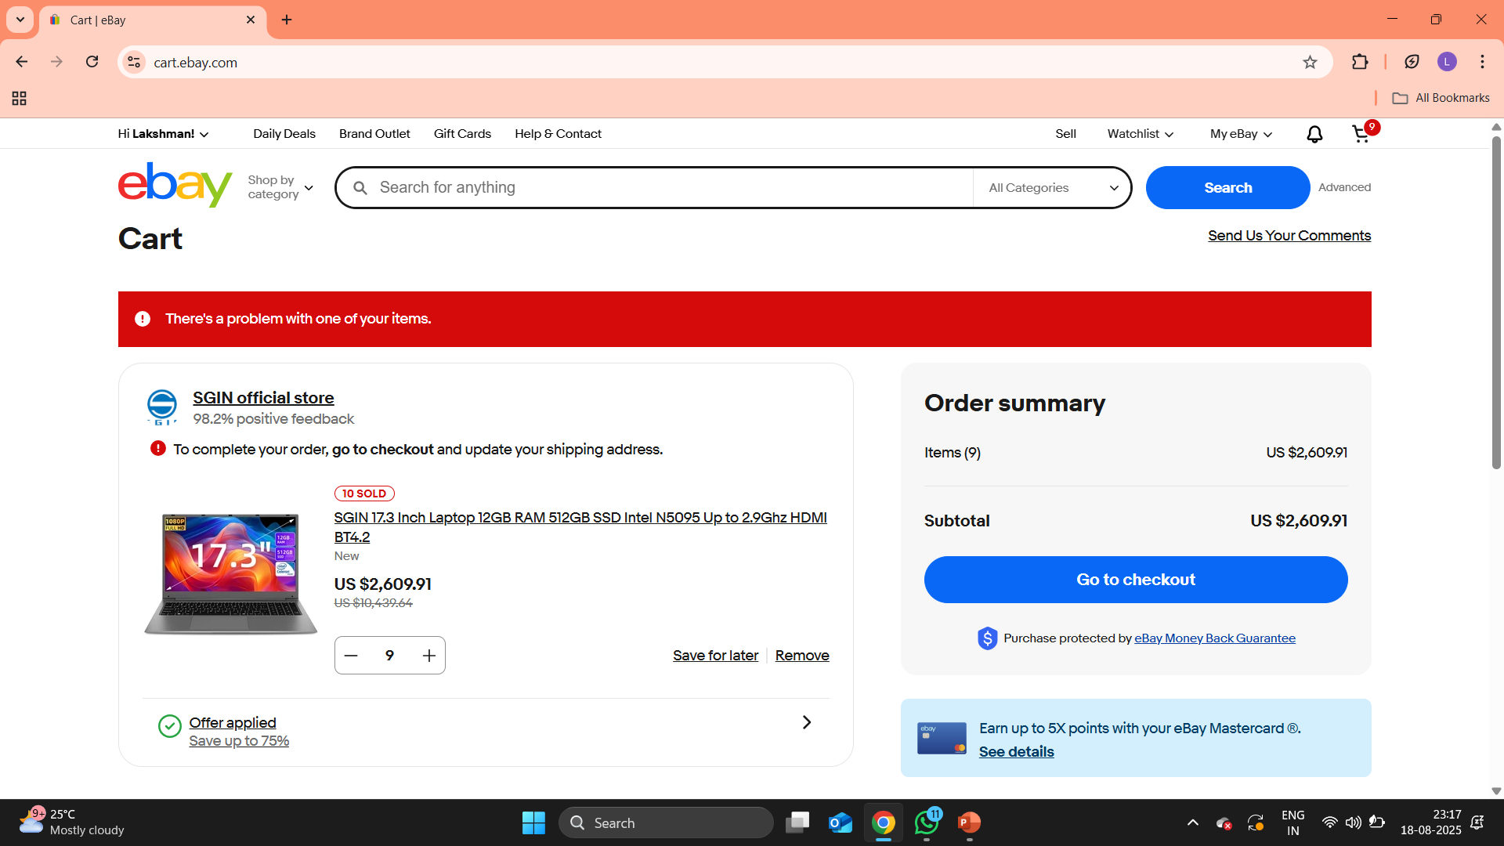

Slide 10
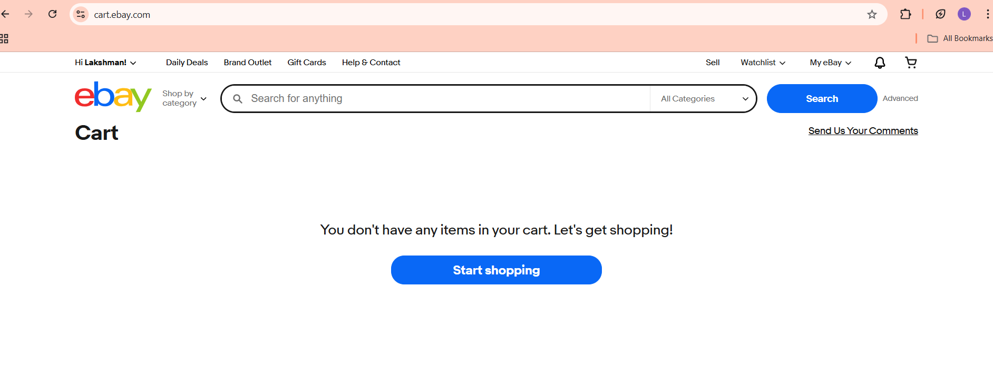

Slide 11
Defect identifier :- B_002
Ø Defect summary :- when applying the “lowest price first”filter in the wishlist,items are incorrectly displayed in highest price first.
Ø Test Id :- ds-002
Ø Test case name :- Verify_Wishlist_Items_Sorted_By_Lowest_Price
Ø Module name :- sorting&filter
Ø Reproducible :-
Ø Severity :- medium
Ø Priority :- medium
Ø Raised by :- lakshman
Ø Assigned to :- developer
Ø Date of assignment :- 19-08-2025
Ø Status :- pending
Ø Snap shots :-
Ø Fixed by :- developer
Ø Date of fixing :-

Slide 12
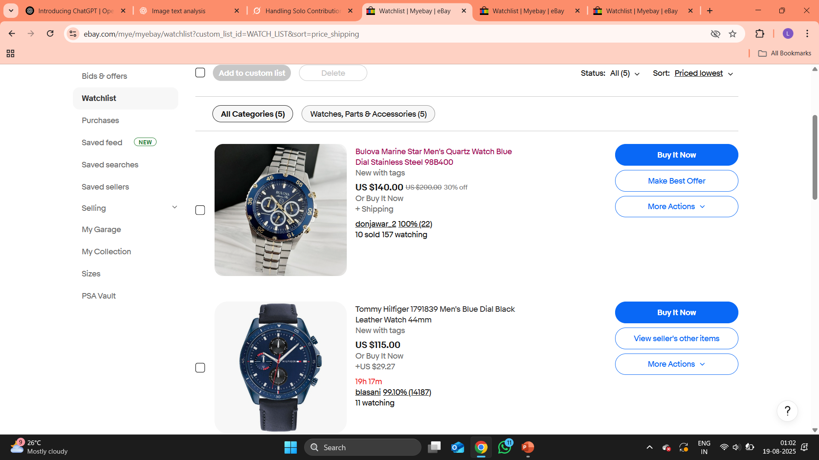
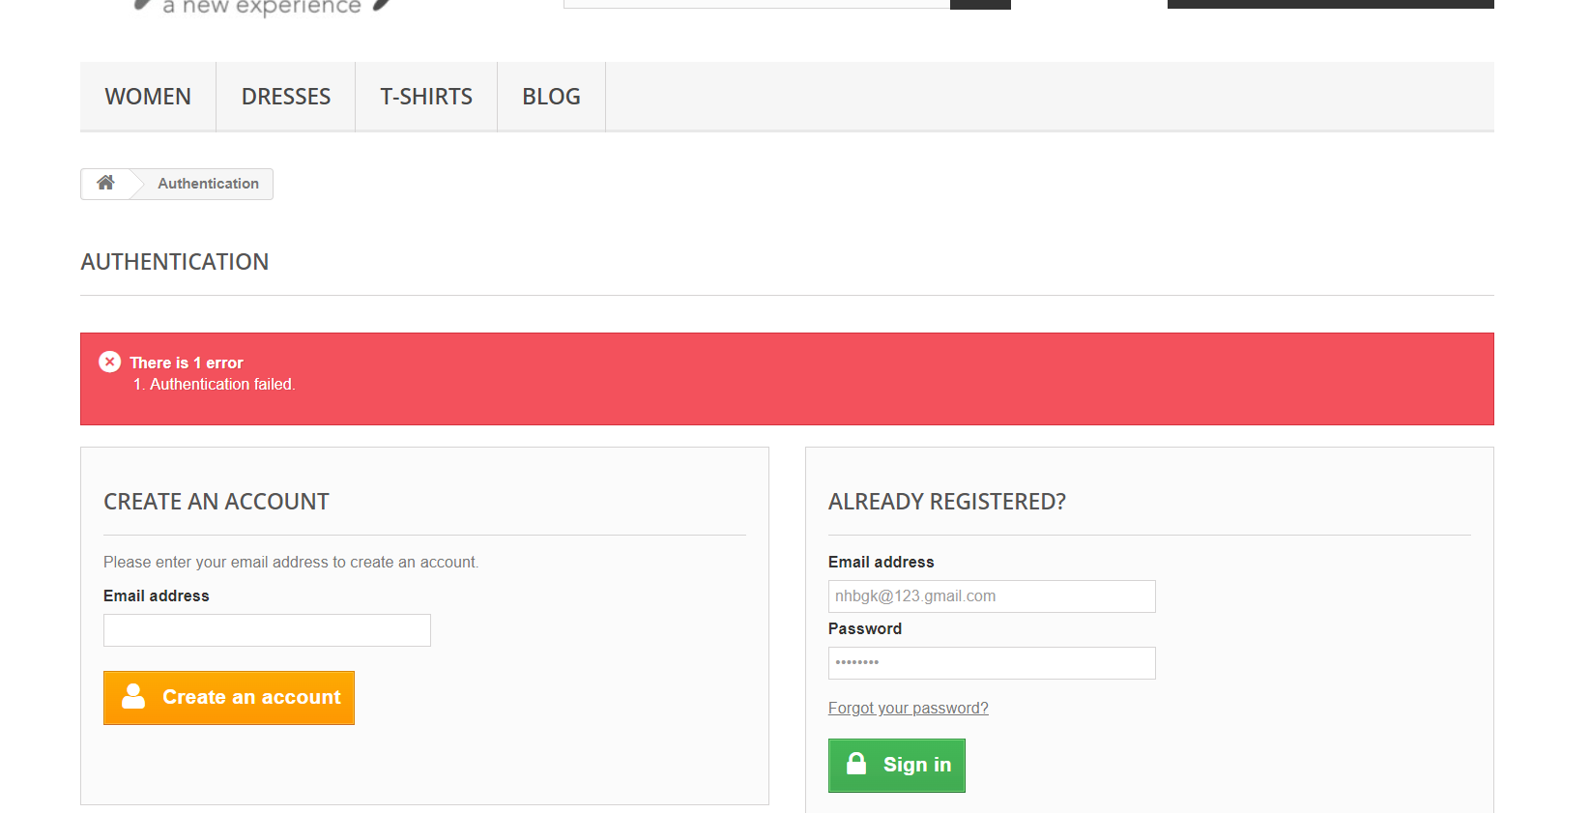

Slide 13
Defect identifier :- B_003
Ø Defect summary :- when searching with a combination of numbers and special characters(eg:ab#%123),the search results incorrectly display items that contain only part of input( like 123) instead of the exact combination and not showing any error message.
Ø Test Id :- ds-003
Ø Test case name :- Verify_Search_With_Numbers_And_Special_Characters
Ø Module name :- Search
Ø Reproducible :-
Ø Severity :- medium
Ø Priority :- medium
Ø Raised by :- lakshman
Ø Assigned to :- developer
Ø Date of assignment :- 19-08-2025
Ø Status :- pending
Ø Snap shots :-
Ø Fixed by :- developer
Ø Date of fixing :-

Slide 14
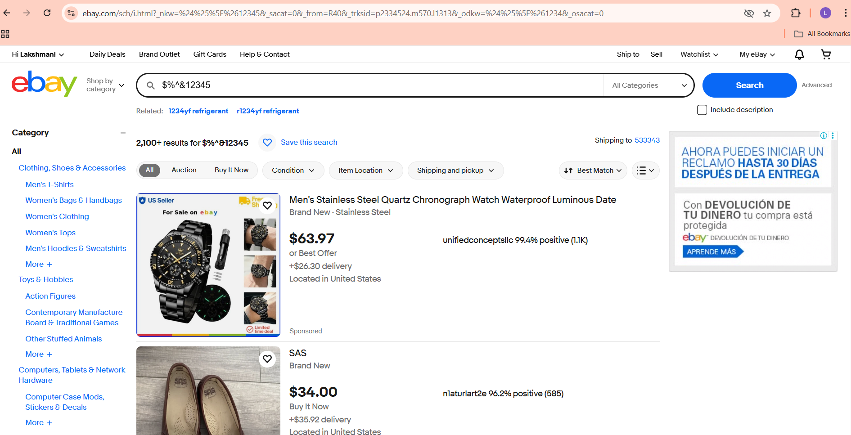

Slide 15
Challenges
While testing this website which contains huge data i faced some challenges about:
Some features like search,cart may not work properly.
Hard to use on all devices;buttons and messages can be confusing.
Works differently on different browsers and devices.
Hard to use real data;product info changes all the time.
Hard to test automatically because pages change often.

Slide 16
Experience
Learned how each feauture works,like login,search,cart.
Able to identify issues like slow pages,or incorrect data.
Learn to create step by step tests for each functionality.
Gained experience with tools like selenium,testing etc...
Learned to document defects clearly with screenshots and descriptions.

Slide 17
Thank You!!!
Vaishali Mam For Guiding Us through out the Project.

